Slide 1

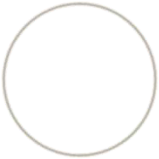




Secure Hash Algorithm-512
(SHA-512)
1

Slide 2

Outlines
SHA-512 overview
processing of SHA-521
word expansion
compression function
round function
additive constants
example using SHA-512
applications
cryptanalysis
2

Slide 3

Overview
Developed by National Institute of Standards and Technology (NIST)
member of SHA-2 family
latest version of Secure Hash Algorithm
based on the Merkle-Damgard scheme
maximum message size 2¹²⁸-1 bits
block size 1024 bits
message digest size 512 bits
number of rounds 80
word size 64 bits
3

Slide 4

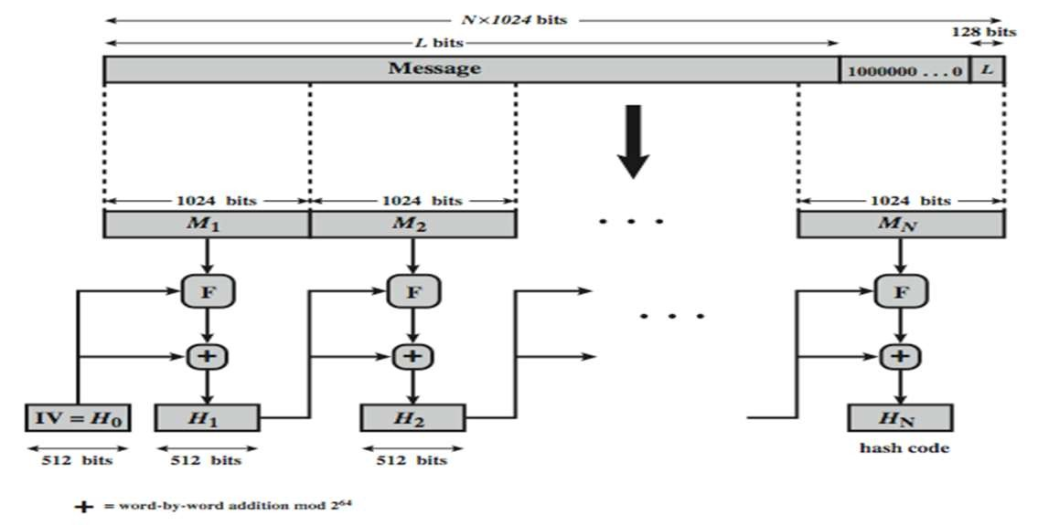
Processing of SHA-512
Figure: SHA-512 Processing of a Single 1024-Bit Block
4

Slide 5
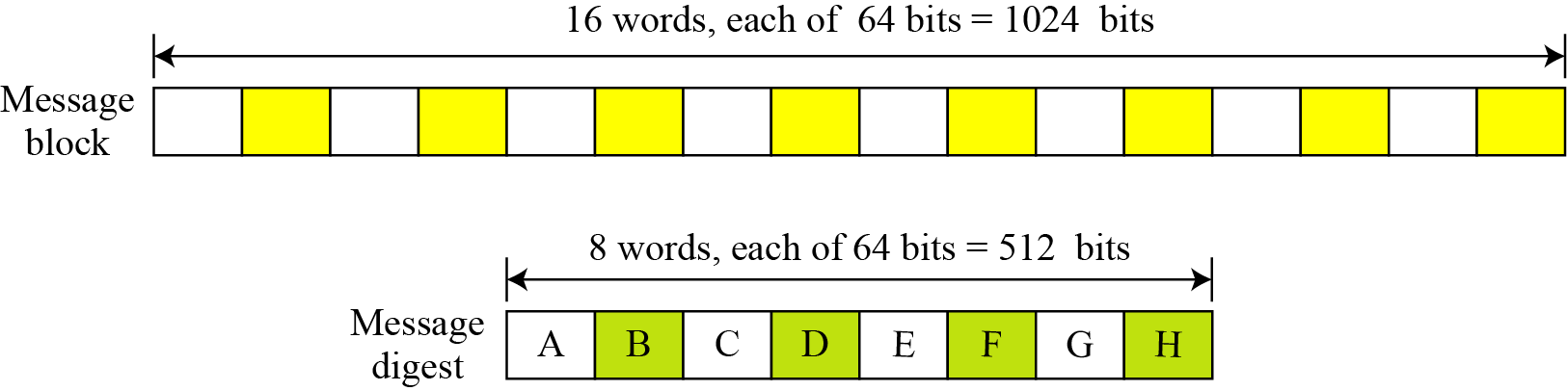
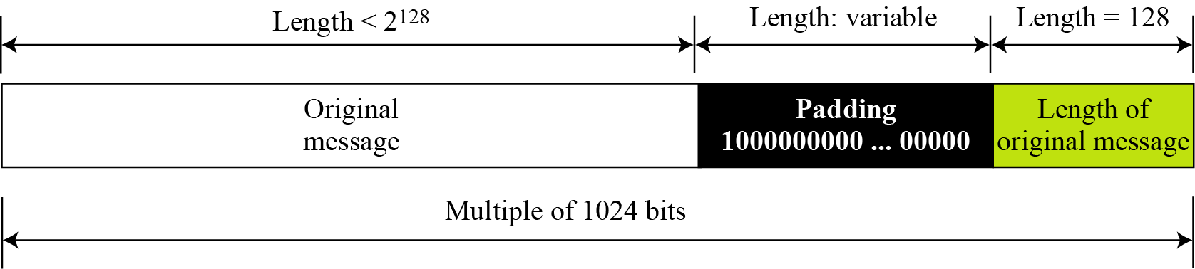
Message block and digest word
Figure: A message block and the digest as words
Figure: Padding and length field
5

Slide 6
Processing of SHA-512
appending padding and fixed 128 bit length field
dividing the augmented message into blocks
using a 64-bit word derived from the current message block
using 8 constants based on square root of first 8 prime numbers (2-19)
updating a 512-bit buffer
using a round constant based on cube root of first 80 prime numbers (2-409)
6

Slide 7

Message block and digest word
operates on words
each block consists of sixteen 64 bits(1024 bits)
words
message digest has eight 64 bits (512 bits) words named A,B,C,D,E,F,G,H
expanding 80 words from sixteen 64 bits words
7

Slide 8

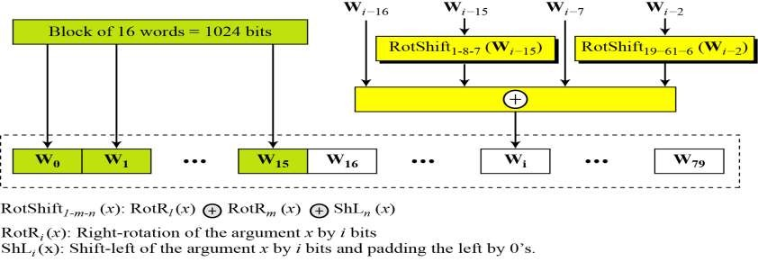
SHA-512 Initial Values & Word Expansion
Buffer | Value (in Hexadecimal) | Buffer | Value (in Hexadecimal)
A0 | 6A09E667F3BCC908 | E0 | 510E527FADE682D1
B0 | BB67AE8584CAA73B | F0 | 9B05688C2B3E6C1F
C0 | 3C6EF372FE94F82B | G0 | 1F83D9ABFB41BD6B
D0 | A54FF53A5F1D36F1 | H0 | 5BE0CD19137E2179
Table : Values of constants in message digest initialization of SHA-512
Figure: Word expansion in SHA-512
8

Slide 9

Calculation of constants
For example,
The 8th prime is 19, with the square root (19)^{1/2}= 4.35889894354 Converting this number to binary with only 64 bits in the fraction part, we get,
(100.0101 1011 1110 …1001)₂ (4.5𝐵𝐸0𝐶𝐷19137𝐸2179)₁₆
The fraction part ∶ (5𝐵𝐸0𝐶𝐷19137𝐸2179)₁₆
The 80th prime is 409, with the cubic root (409)^{1/3} = 7.42291412044. Converting this number to binary with only 64 bits in the fraction part, we get
The fraction part: (6C44198C4A475817)₁₆
9

Slide 10

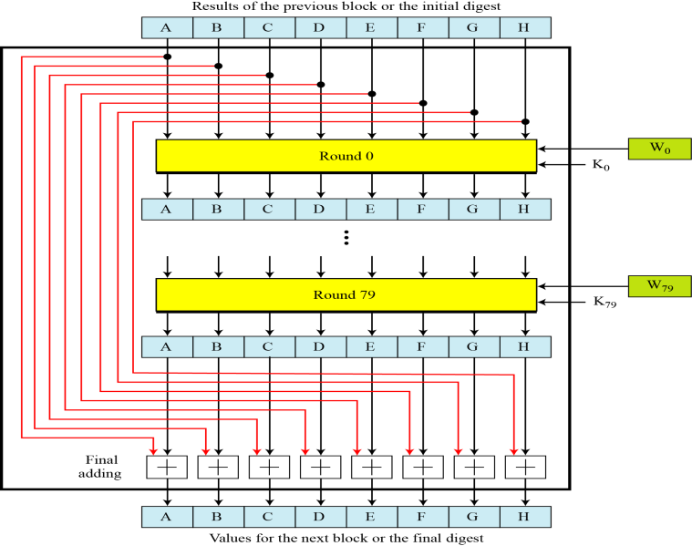
SHA-512 Compression Function
Figure: Compression Function in SHA-512
10

Slide 11

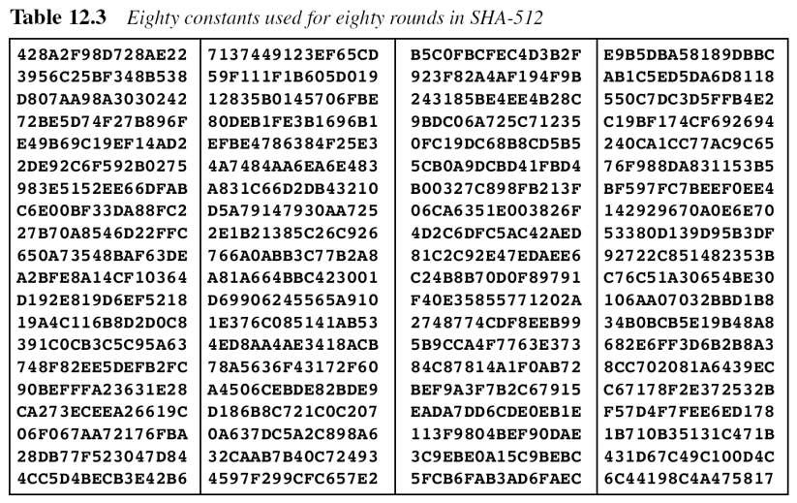
SHA-512 Round constants (K)
Figure: List of round constants used in SHA-512
11

Slide 12

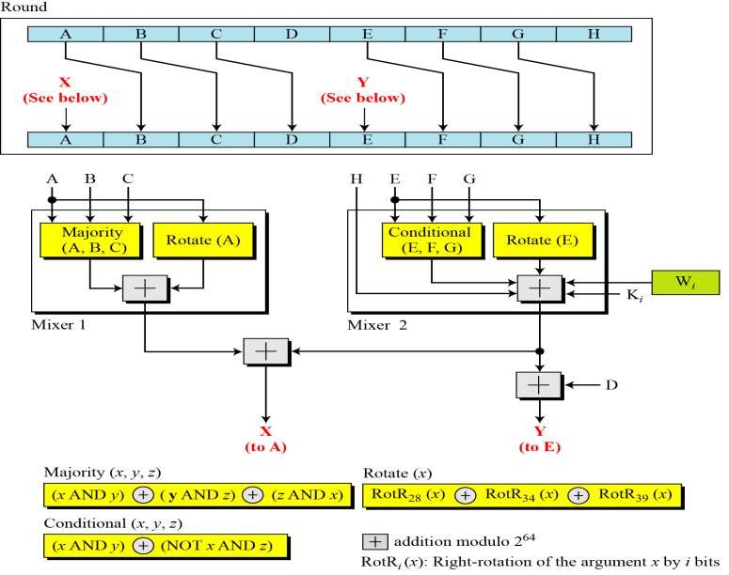
SHA-512 Round Function
Figure: Structure of each round in SHA-512
12

Slide 13


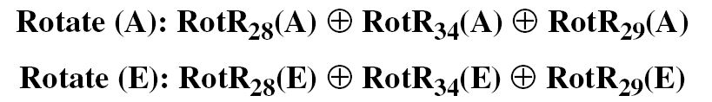
SHA-512 Round Function
Majority Function
Conditional Function
Rotate Functions
April 5, 2016

Slide 14
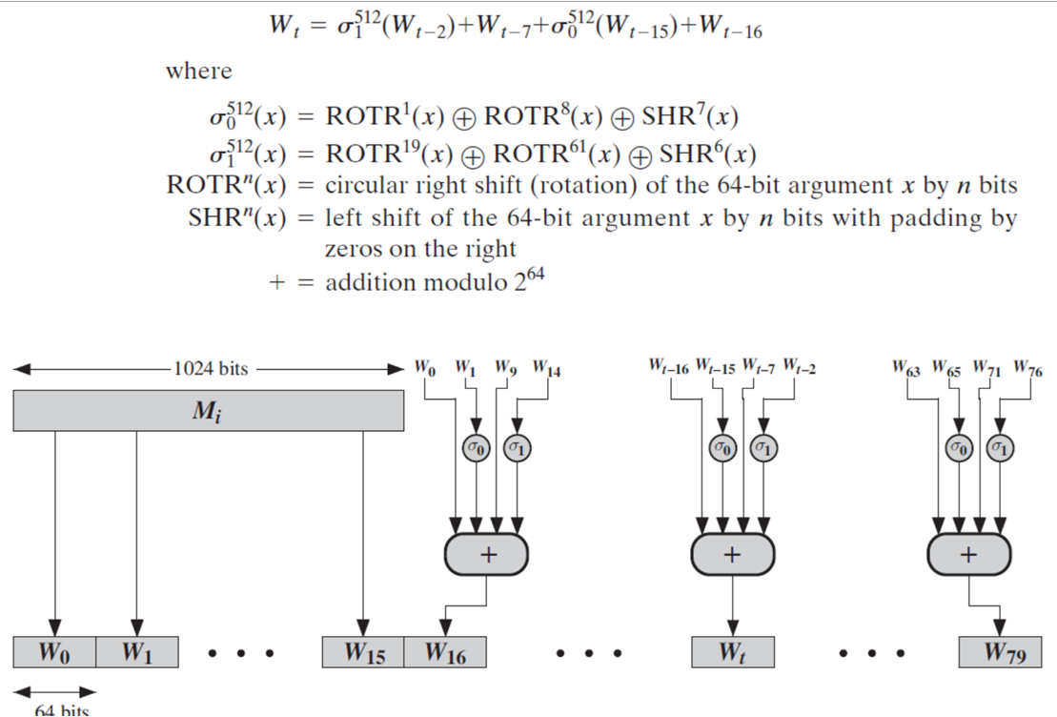
Derivation of Wt (64-bit)

Slide 15

SHA-512 Majority Function calculation
We apply the Majority function on buffers A, B, and C. If the leftmost hexadecimal digits of these buffers are 0x7, 0xA, and 0xE, respectively, what is the leftmost digit of the result?
Solution
The digits in binary are 0111, 1010, and 1110.
The first bits are 0, 1, and 1. The majority is 1.
The second bits are 1, 0, and 1. The majority is 1.
The third bits are 1, 1, and 1. The majority is 1.
The fourth bits are 1, 0, and 0. The majority is 0.
The result is 1110, or 0xE in hexadecimal.

Slide 16

SHA-512 Conditional Function calculation
We apply the Conditional function on E, F, and G buffers. If the leftmost hexadecimal digits of these buffers are 0x9, 0xA, and 0xF respectively, what is the leftmost digit of the result?
Solution
The digits in binary are 1001, 1010, and 1111.
The first bits are 1, 1,and 1.The result is F₁, which is 1.
The second bits are 0,0, and 1. The result is G₂, which is 1.
The third bits are 0,1,and 1.The result is G₃, which is 1.
The fourth bits are 1,0,and 1.The result is F₄, which is 0. The result is 1110, or 0xE in hexadecimal.
April 5, 2016

Slide 17

Example using SHA-512
ASCII characters: “abc”, which is equivalent to the following 24-bit binary string:
01100001 01100010 01100011 = 616263 in Hexadecimal
The original length is 24 bits, or a hexadecimal value of 18.
the 1024-bit message block, in hexadecimal, is
6162638000000000 0000000000000000 0000000000000000 0000000000000000
0000000000000000 0000000000000000 0000000000000000 0000000000000000
0000000000000000 0000000000000000 0000000000000000 0000000000000000
0000000000000000 0000000000000000 0000000000000000 0000000000000018
W0 | = 6162638000000000 | W5 = 0000000000000000
W1 | = 0000000000000000 | W6 = 0000000000000000
W2 | = 0000000000000000 | W7 = 0000000000000000
W3 | = 0000000000000000 | W8 = 0000000000000000
W4 | = 0000000000000000 | W9 = 0000000000000000
W10 = 0000000000000000
W11 = 0000000000000000
W13 = 0000000000000000
W14 = 0000000000000000
W12 = 0000000000000000
W15 = 0000000000000018
April 5, 2016

Slide 18
Example using SHA-512
The following table shows the initial values of these variables and their values after each of the first two rounds.
a | 6a09e667f3bcc908 | f6afceb8bcfcddf5 | 1320f8c9fb872cc0
b | bb67ae8584caa73b | 6a09e667f3bcc908 | f6afceb8bcfcddf5
c | 3c6ef372fe94f82b | bb67ae8584caa73b | 6a09e667f3bcc908
d | a54ff53a5f1d36f1 | 3c6ef372fe94f82b | bb67ae8584caa73b
e | 510e527fade682d1 | 58cb02347ab51f91 | c3d4ebfd48650ffa
f | 9b05688c2b3e6c1f | 510e527fade682d1 | 58cb02347ab51f91
g | 1f83d9abfb41bd6b | 9b05688c2b3e6c1f | 510e527fade682d1
h | 5be0cd19137e2179 | 1f83d9abfb41bd6b | 9b05688c2b3e6c1f
The process continues through 80 rounds. The output of the final round is
73a54f399fa4b1b2 10d9c4c4295599f6 d67806db8b148677 654ef9abec389ca9 d08446aa79693ed7 9bb4d39778c07f9e 25c96a7768fb2aa3 ceb9fc3691ce8326

Slide 19
Example using SHA-512
The hash value is then calculated as
H1,0 = 6a09e667f3bcc908 + 73a54f399fa4b1b2 = ddaf35a193617aba
H1,1 = bb67ae8584caa73b + 10d9c4c4295599f6 = cc417349ae204131
H1,2 = 3c6ef372fe94f82b + d67806db8b148677 = 12e6fa4e89a97ea2
H1,3 = a54ff53a5f1d36f1 + 654ef9abec389ca9 = 0a9eeee64b55d39a
H1,4 = 510e527fade682d1 + d08446aa79693ed7 = 2192992a274fc1a8
H1,5 = 9b05688c2b3e6c1f + 9bb4d39778c07f9e = 36ba3c23a3feebbd
H1,6 = 1f83d9abfb41bd6b + 25c96a7768fb2aa3 = 454d4423643ce80e
H1,7 = 5be0cd19137e2179 + ceb9fc3691ce8326 = 2a9ac94fa54ca49f
The resulting 512-bit message digest is
ddaf35a193617aba cc417349ae204131 12e6fa4e89a97ea2 0a9eeee64b55d39a
2192992a274fc1a8 36ba3c23a3feebbd 454d4423643ce80e 2a9ac94fa54ca49f

Slide 20
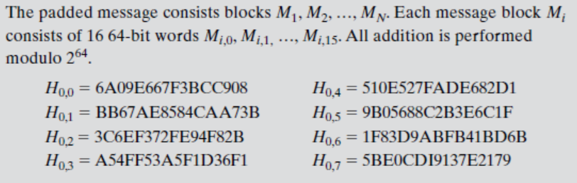
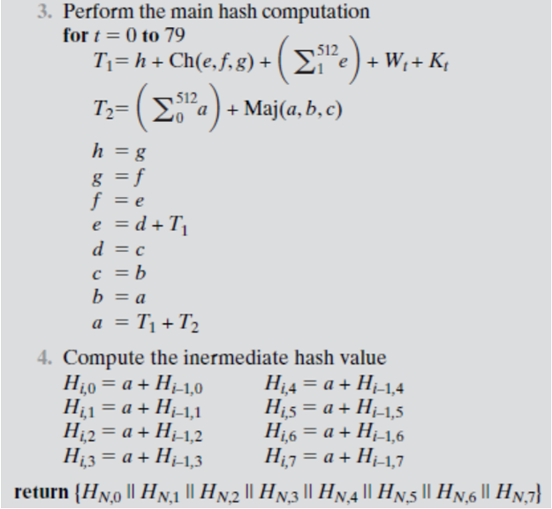
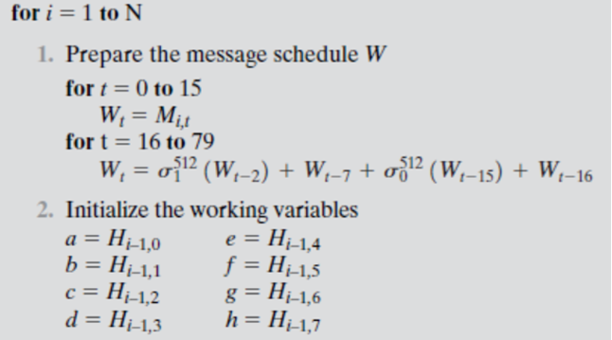
SHA-512 Steps

Slide 21

SHA-512 Applications
Used as part of a system to authenticate archival video from the International Criminal Tribunal of the Rwandan genocide.
Proposed for use in DNSSEC
are moving to 512-bit SHA-2 for secure password hashing by Unix and Linux vendors

